Slide 1
Lecture 9: Stream-network spatial models
May 22, 2018
Learning goals:
Understand how to specify a spatial model on a stream network

Slide 3
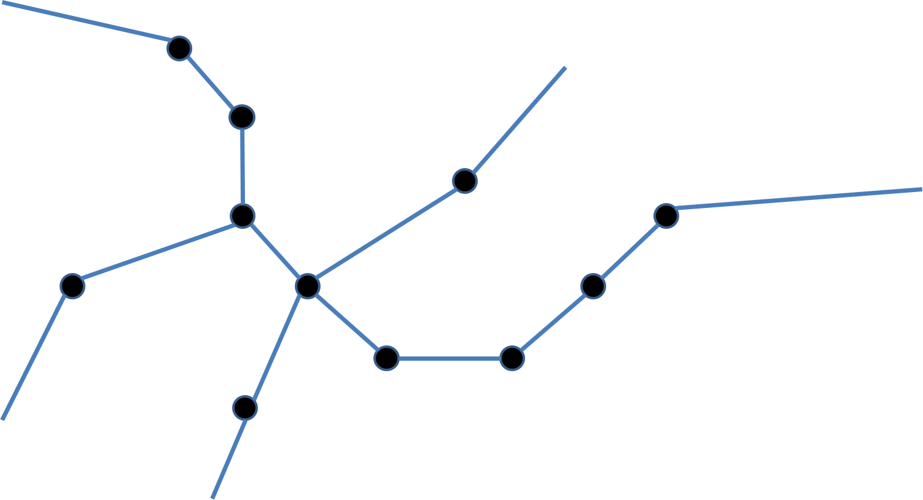
Stream networks
Imagine you have samples on a stream network
Notes:
Strong French spatial statisticians (1990s, kriging on fisheries)
NA block kriging (eg Ver Hoeff student of wikle, Peterson)
Equally spaced obs are the worst for estimating spatial model

Slide 4
Stream networks
How to estimate detection probability?
Design an experiment with replicated sampling!
Closed-population tag-recapture
Occupancy models
Triple-pass depletion sampling
…
Extensions to model-based replicates
Open-population tag-recapture
Dynamic occupancy models
…
Notes:
Boils down to time and spatial scale with the assumption of population closure

Slide 5
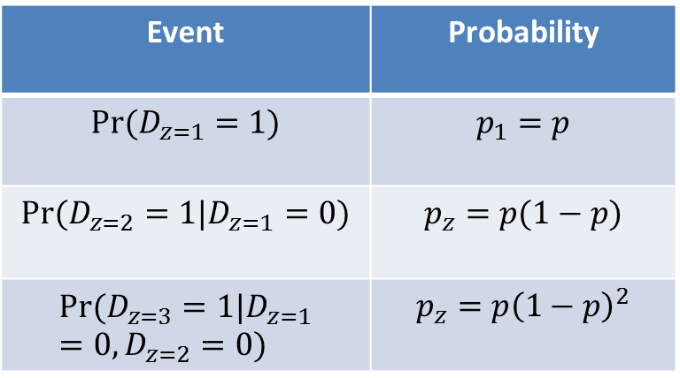
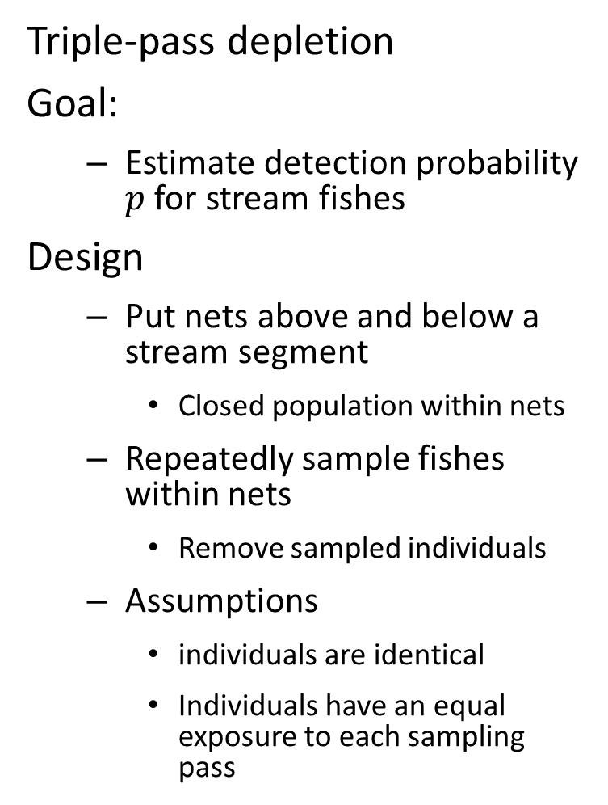
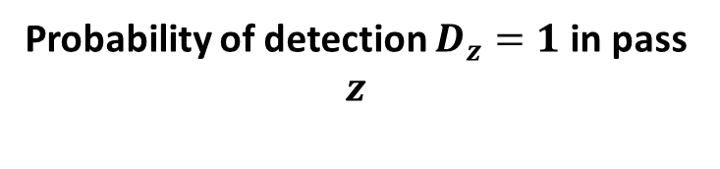
Stream networks
Triple-pass depletion
Goal:
Estimate detection probability $p$ for stream fishes
Design
Put nets above and below a stream segment
Closed population within nets
Repeatedly sample fishes within nets
Remove sampled individuals
Assumptions
individuals are identical
Individuals have an equal exposure to each sampling pass
Probability of detection $D_{z}=1$ in pass $z$
Event | Probability
$$Pr⁡(D_{z=1}=1)$$ | $$p_{1}=p$$
$$Pr⁡(D_{z=2}=1|D_{z=1}=0)$$ | $$p_{z}=p(1−p)$$
$$Pr⁡(D_{z=3}=1|D_{z=1}=0,D_{z=2}=0)$$ | $$p_{z}=p{\left(1−p\right)}^{2}$$

Slide 6
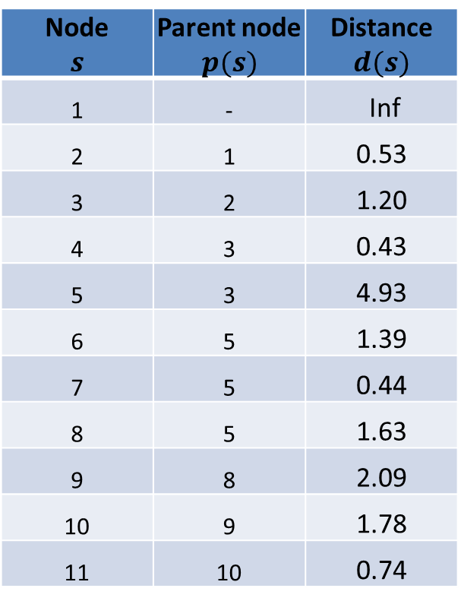
Stream networks
How to define spatial model on streams?
Define an directed acyclic graph (DAG) for network
1
Node $$s$$ | Parent node $$p(s)$$ | Distance $$d(s)$$
1 | - | Inf
2 | 1 | 0.53
3 | 2 | 1.20
4 | 3 | 0.43
5 | 3 | 4.93
6 | 5 | 1.39
7 | 5 | 0.44
8 | 5 | 1.63
9 | 8 | 2.09
10 | 9 | 1.78
11 | 10 | 0.74
11
Notes:
Node one has no parent so it’s an infinite distance from it’s parent
Won’t matter which way you think of the “parent” direction

Slide 7
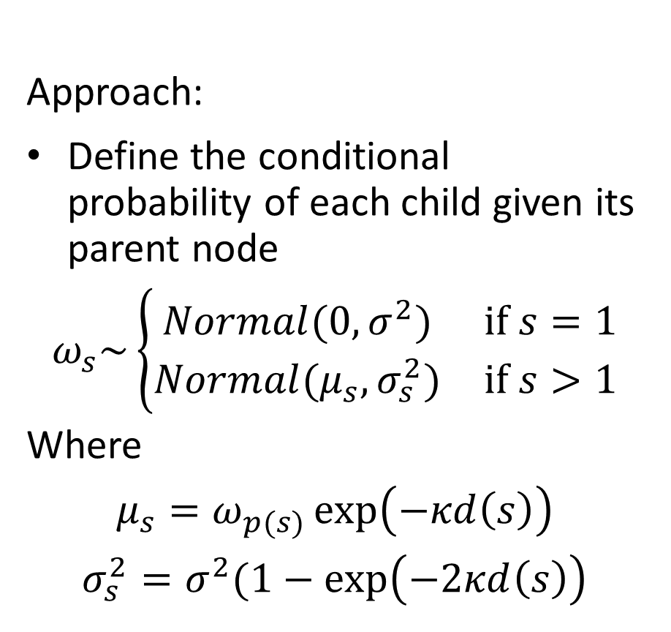
Stream networks
How to define spatial model on streams?
Define an directed acyclic graph (DAG) for network
Approach:
Define the conditional probability of each child given its parent node
$$ω_{s}\sim \left\{\begin{matrix}Normal(0,σ^{2}) & if s=1 \\ Normal(μ_{s},σ_{s}^{2}) & if s>1\end{matrix}\right.$$
Where
$$μ_{s}=ω_{p(s)}\exp\left(−κd\left(s\right)\right)$$
$$σ_{s}^{2}=σ^{2}(1−\exp\left(−2κd\left(s\right)\right)$$
Node $$s$$ | Parent node $$p(s)$$ | Distance $$d(s)$$
1 | - | Inf
2 | 1 | 0.53
3 | 2 | 1.20
4 | 3 | 0.43
5 | 3 | 4.93
6 | 5 | 1.39
7 | 5 | 0.44
8 | 5 | 1.63
9 | 8 | 2.09
10 | 9 | 1.78
11 | 10 | 0.74
Notes:
w_p(s) is value of parent node, d(s) is the distance between the two
Exponential correlation function of stream distance
Variance is zero at distance 0
When distance is infinite, term goes to 1 and variance goes to the marginal variance of the process
Kappa = decorrelation rate
Sigma is marginal variance as dist goes to infinity
Same formulas as in Ornstein Ulenbeck process (week 5?) → which is a first order unequal time process
Main restrictions- exponential decay by distance, upstream/downstream doesn’t matter, must be a DAG

Slide 8
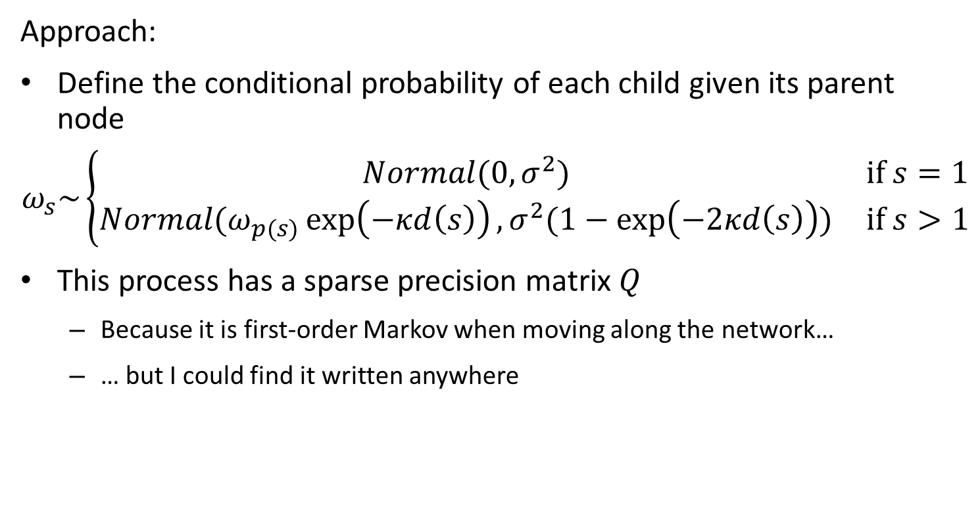
Stream networks
How to define spatial model on streams?
Define an directed acyclic graph (DAG) for network
Approach:
Define the conditional probability of each child given its parent node
$$ω_{s}\sim \left\{\begin{matrix}Normal(0,σ^{2}) & if s=1 \\ Normal(ω_{p(s)}\exp\left(−κd\left(s\right)\right),σ^{2}(1−\exp\left(−2κd\left(s\right)\right)) & if s>1\end{matrix}\right.$$
This process has a sparse precision matrix $Q$
Because it is first-order Markov when moving along the network…
… but I could find it written anywhere
Notes:
This is the conditional/state-space parameterization
But it’s nice to also have the inverse precision matrix directly (nice properties, like sparseness due to conditional independent) including using GMRF function to efficiently compute the pdf

Slide 9
Stream networks
How to define spatial model on streams?
Define an directed acyclic graph (DAG) for network
[see code to check Q calculation using TMB inner hessian]

Slide 10
Stream networks
How to define spatial model on streams?
Define an directed acyclic graph (DAG) for network
[see code to confirm that both approaches give same result]

Slide 11

Stream networks
Exercise
Add spatial variation in detection probability $p$ using stream-network distance

Slide 12
Change in support Intro
Notes:
Multiple data types
Point process models here, mostly, and mentioned areal models, but haven’t done much
Sampling at red points
Make a bunch of blue points where we want random effects
County level is an areal model---doesn’t give any more info about what’s going on in there
Location-level data is taken at the points, within this
Integral projection models in ecology do the same sort of things for other continuous variables
We can do the same thing for the point count part of the model, but how do we handle the areal model?
Point gets value that’s an integral across the value of the square/area part—but that’s expensive
Can use the mean of the model density within the polygon (coarse approximation)
Or use INLA and it will smooth over that too
Integral of fine-scale variables within the area to get at big area issue
Go from fine-scale to coarse-scale by integration (or summing)
Need data to be as coarse or coarser than the scale of the model, so formulate model accordingly
Identifiability issues with using the laplace approximation if you only have areal data, because points inside the areas are sort of interchangeable
Package—TMB STAN will do sampling on a TMB model with STAN → could be a cool way to check the identifiability!
No SPDE approximation, no sparse matrices in STAN
John Page PhD student of John Wakefiled (“Jonno”) is working on this stuff

